Slide 1

ADE-Online shoppers intention
Presented by / Jamilah Rabeh
Supervised by/ Dr. Mejdel Alqahtani

Slide 2

Main Goal
What are the behaviors of online shoppers according to browsing shopping site ?
what is the main features that have a clear impact to increase revenue from the customers ?
Provide recommendations according to our results

Slide 3

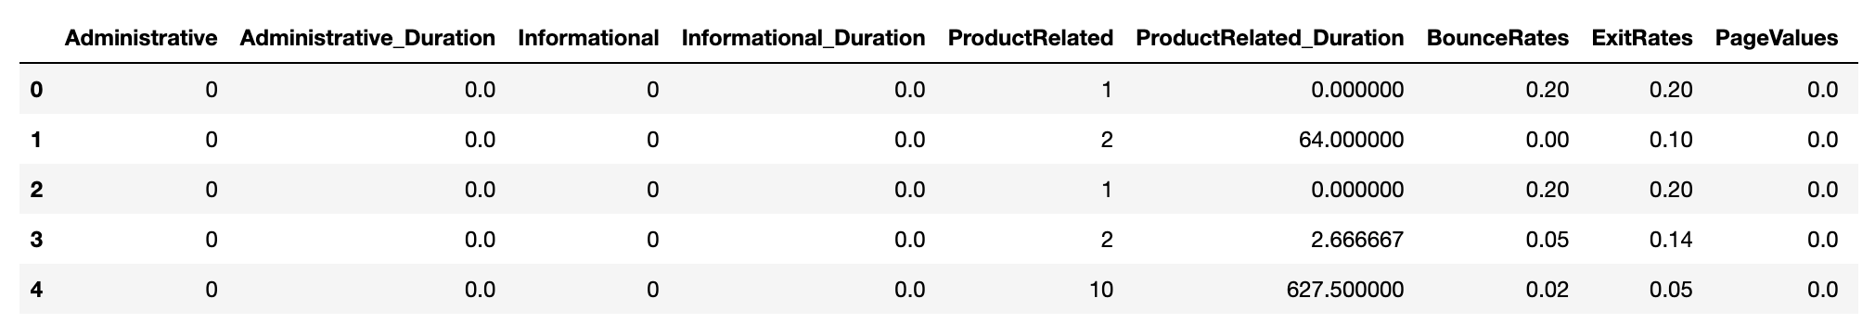
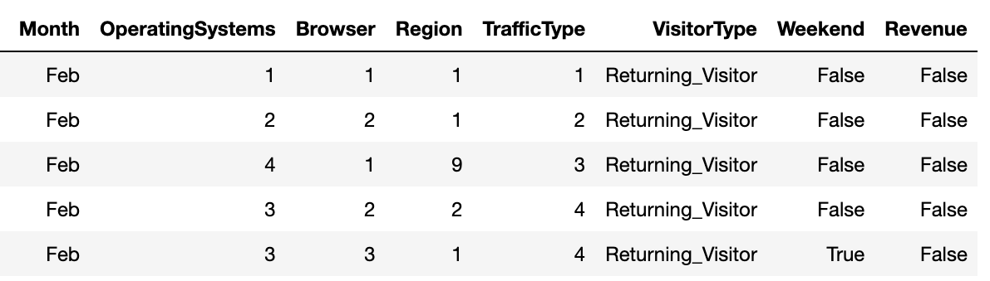
Data set
I obtain the dataset from UCI Machine Learning Repository that collected in 2018-08-31
dataset contain 18 columns and more than 12000 observations , Data size 12379 x 18

Slide 4
Preprocessing steps
Data cleaning
correlation between features
Analysis outlires
visualization

Slide 5

Data Cleaning
Check on missing values
Remove duplicated rows
Check on negative value on duration features
Rename element in Month:
df["Month"].replace({"June": "Jun"}, inplace=True)
Remove unnecessary data
Analysis outliers and removed

Slide 6
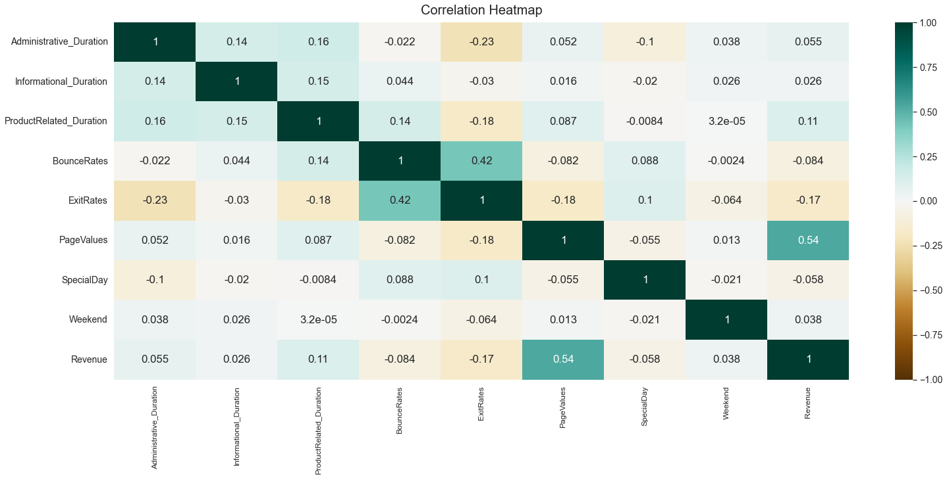
Correlation between features

Slide 7
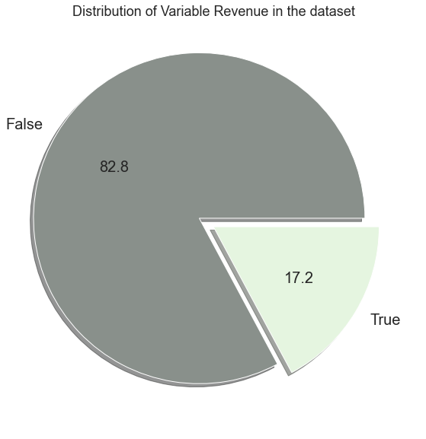
the target column in our data is revenue
Visuilazation- Target column

Slide 8
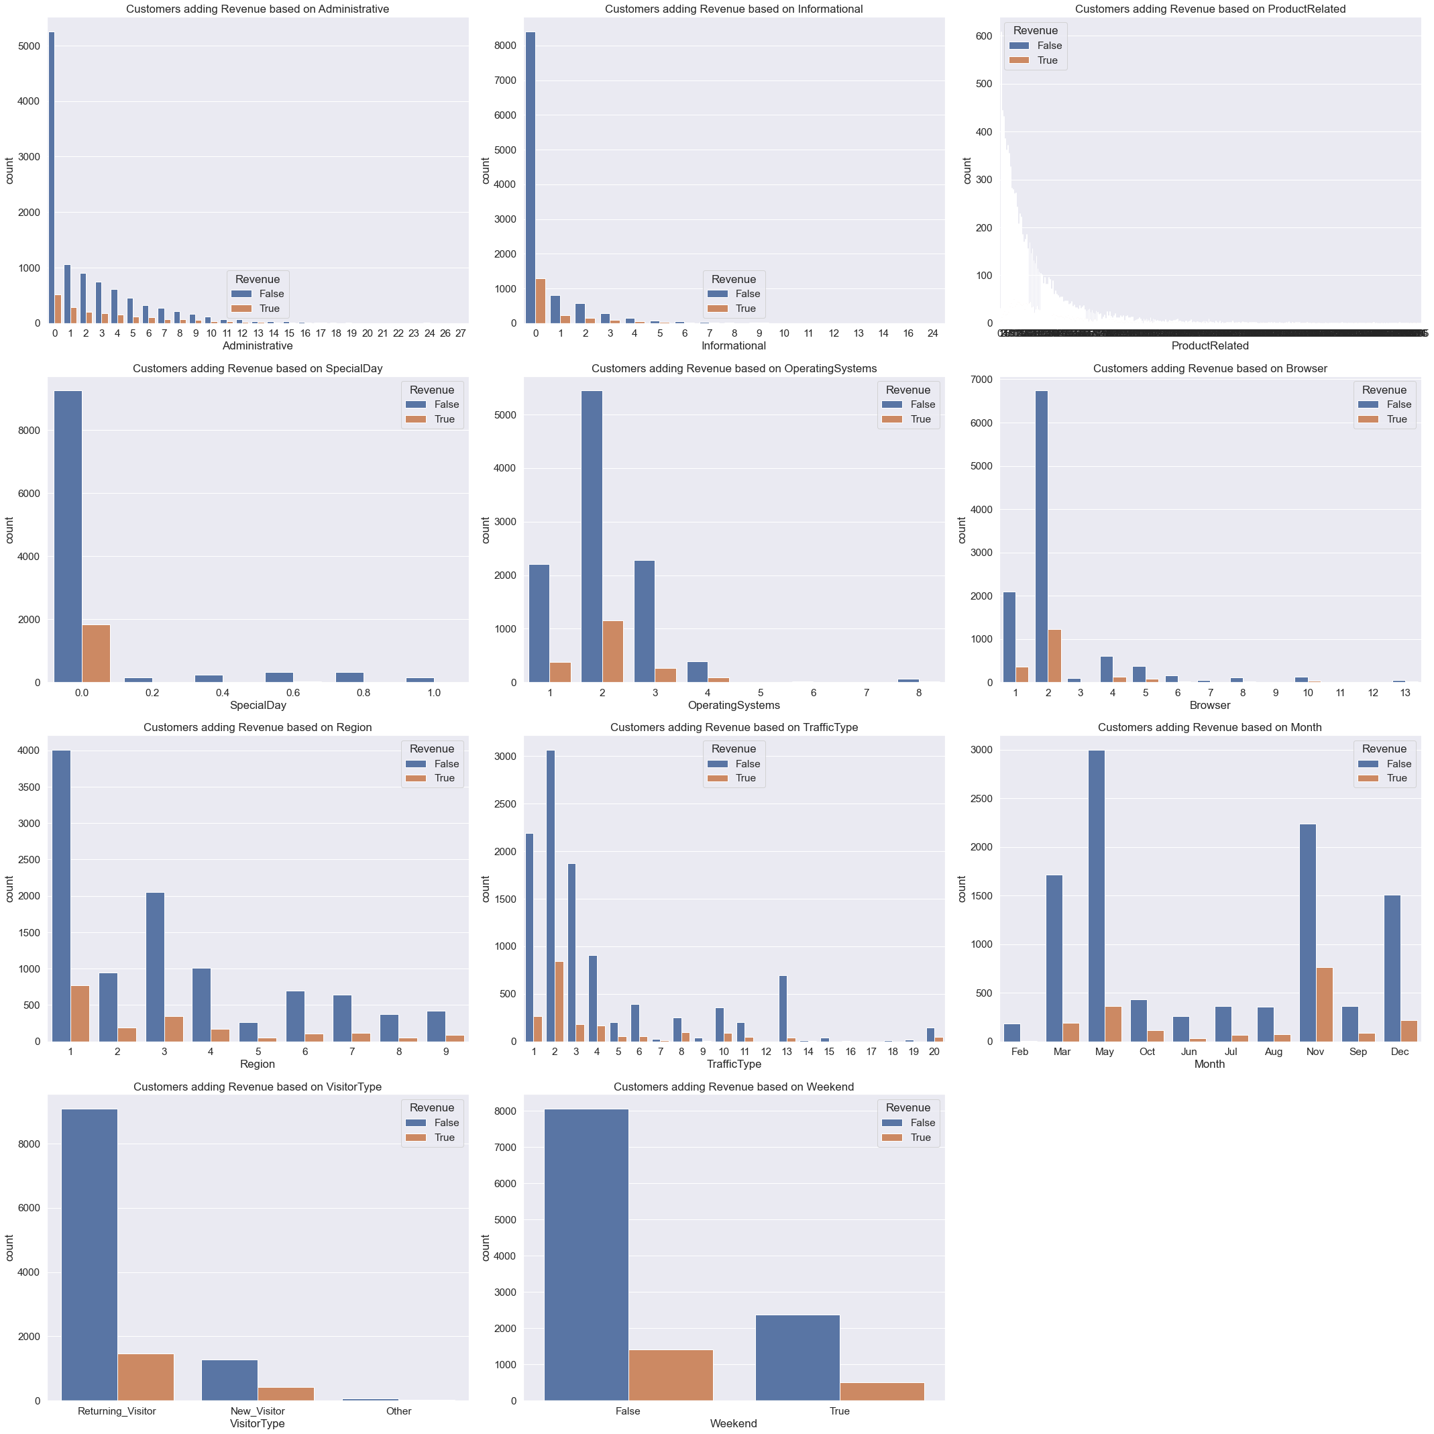
Visuilazation- other column

Slide 10
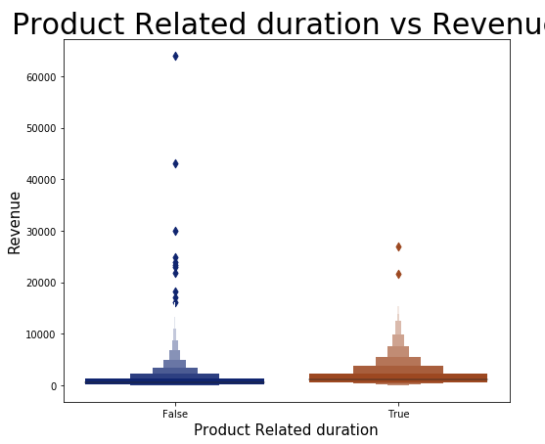

Slide 11
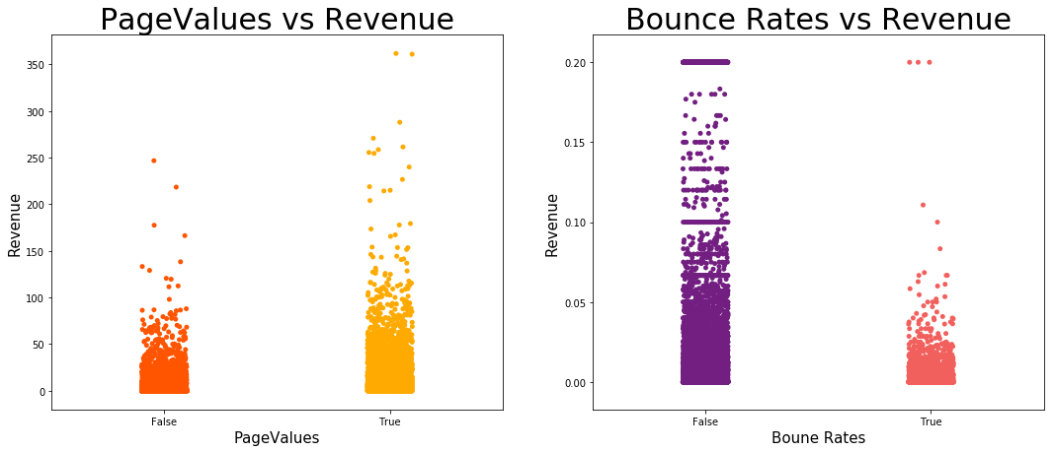

Slide 12
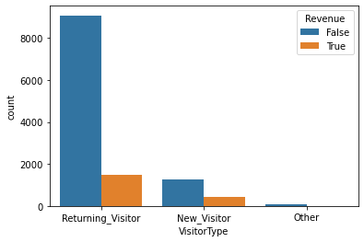

Slide 13
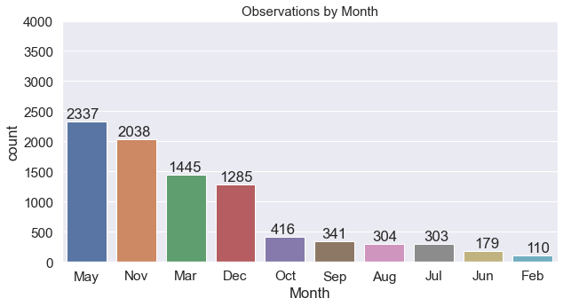

Slide 15
Recommendations
The owner should provide Ads in weekdays more than weekend according to our result
The owner should care about the customers in regions (5,9 and 8)
The owner should gives offers to new visitors to attract them and also in Feb because its corresponding valentines day
The owner should make web site interface and products show more attractive to increase positive rating on google and increase revenue

